Slide 1
Study Portal
Created By:- Antima Chauhan

Slide 2
Introduction:-
The Study portal is a web-based application that helps to make study easier for all by providing a managed environment containing many features which are useful in the study. It contains 7 features related to the study. Users can use these features by simply registering themselves to the portal.
1.ToDo:
The User can take the track and plan their day by creating To-do for their day. Which will help to increase productivity, Improve time management as well as workflow.
2. Creating notes:
Through the notes-creating process, users can create, update, download, and delete notes according to their needs.

Slide 3
3. notes sharing:
Through the notes, sharing process users can upload, download, search and view the study notes uploaded by others. The user can also edit the notes uploaded by him.
4. discussion forum:
forum is an area where users can share their thoughts, and ideas, ask questions or help others by posting answers.
5. find books online:
find book section allows users to find their desired book online from the portal by simply entering the book name he will get a list of all books related to his search.
6. language translator:
Language translator allows users to type or paste text in the input box and select desired language to translate and listen into a natural voice.
7. pdf reader:
It allows users to listen to their favorite book in their desired language by simply importing a pdf file into the input box and selecting the desired language.

Slide 4
Objective:
The main objective of building the Study Portal is to provide study tools in one place that helps to save time and make study easier.
The Major Objective of this project are :
To develop a generic software which will help in the study that can be used by students and teachers as well with centralized control of admin where users will able to choose their branch and access data according to their branch and can use other features like Create notes, to-do, language translator, book search functionality, and pdf reader according to their need.
The User will be able to ask questions and post replies to others’ questions. User can access their branch notes and search notes via the subject, title

Slide 5
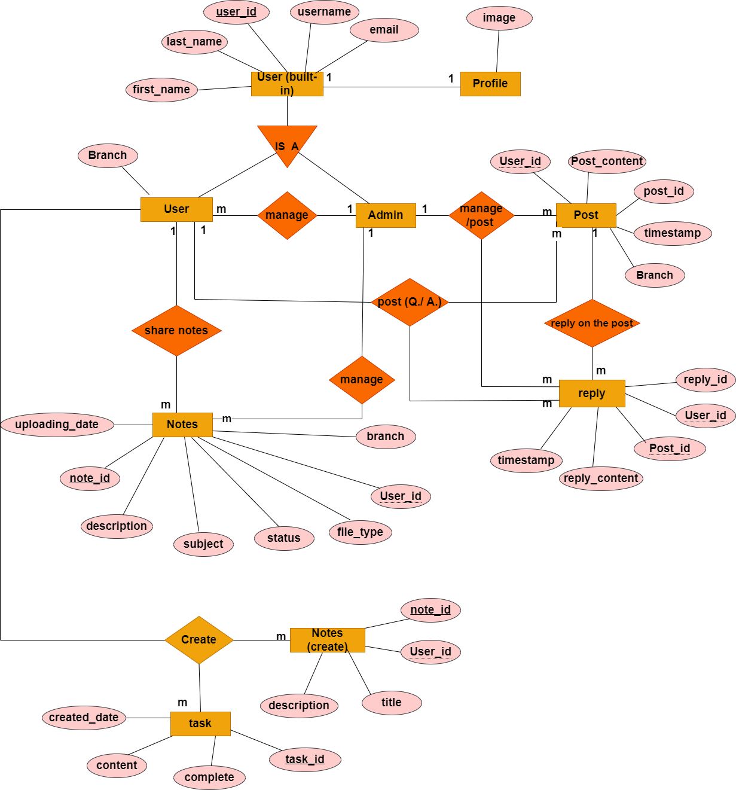
ER Diagram

Slide 6
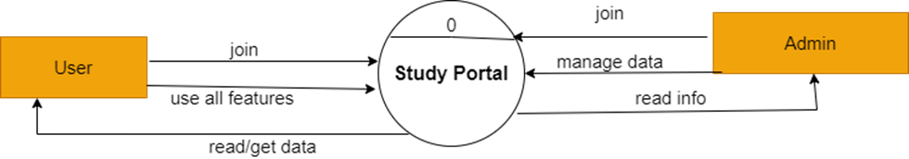
Data Flow Diagram
Zero level DFD

Slide 7
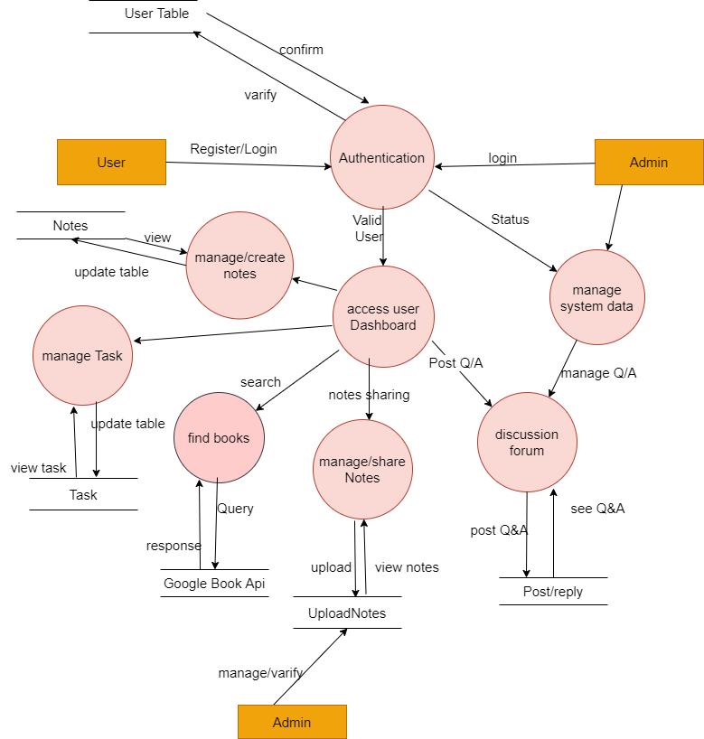
First level DFD

Slide 8
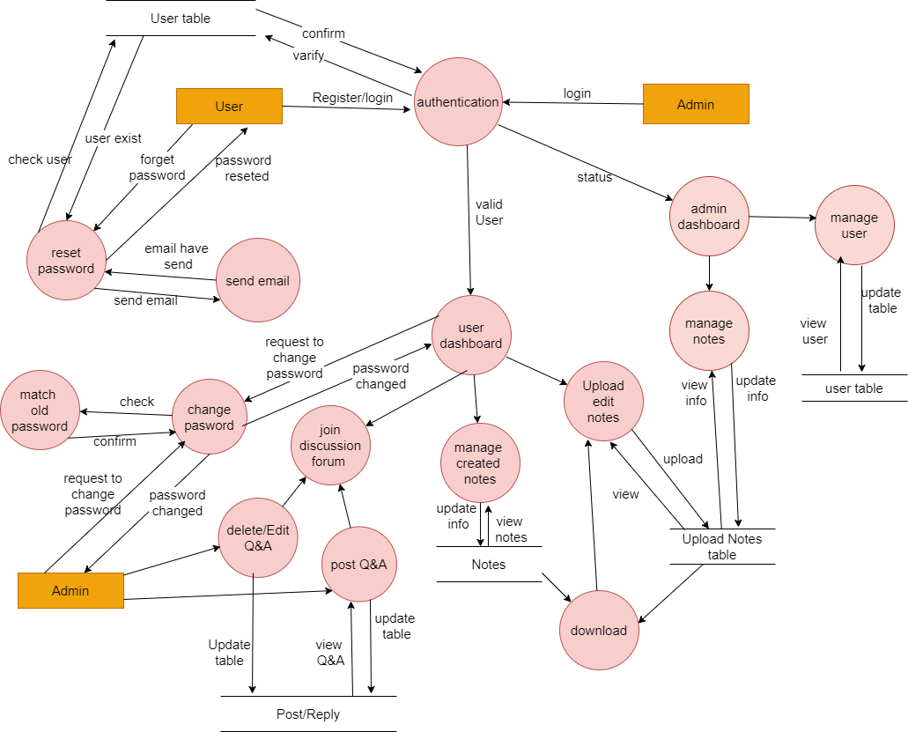
Second level DFD

Slide 9
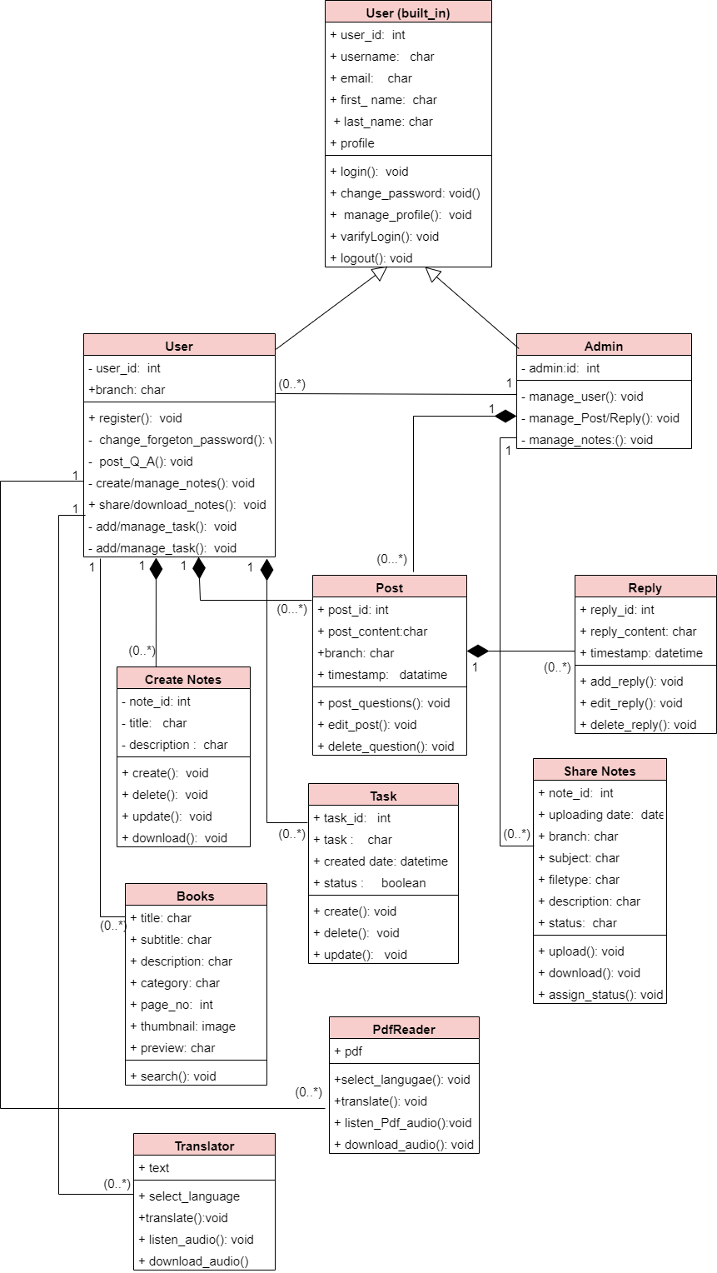
Class Diagram

Slide 10
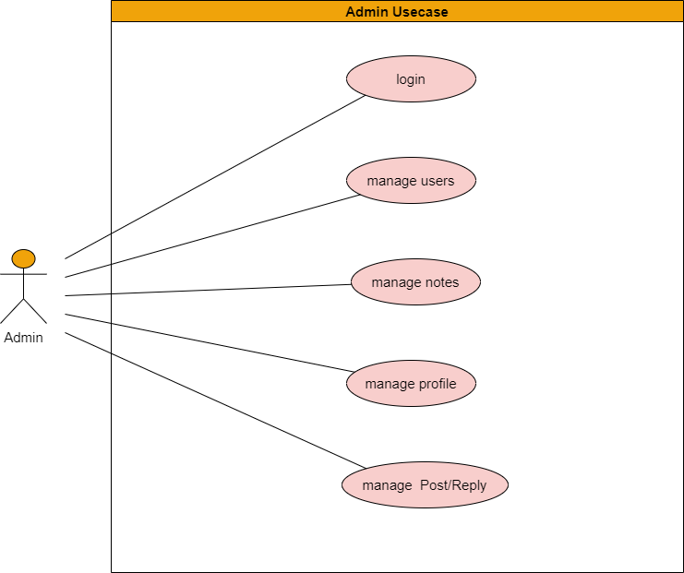
Admin Use case Diagram

Slide 11
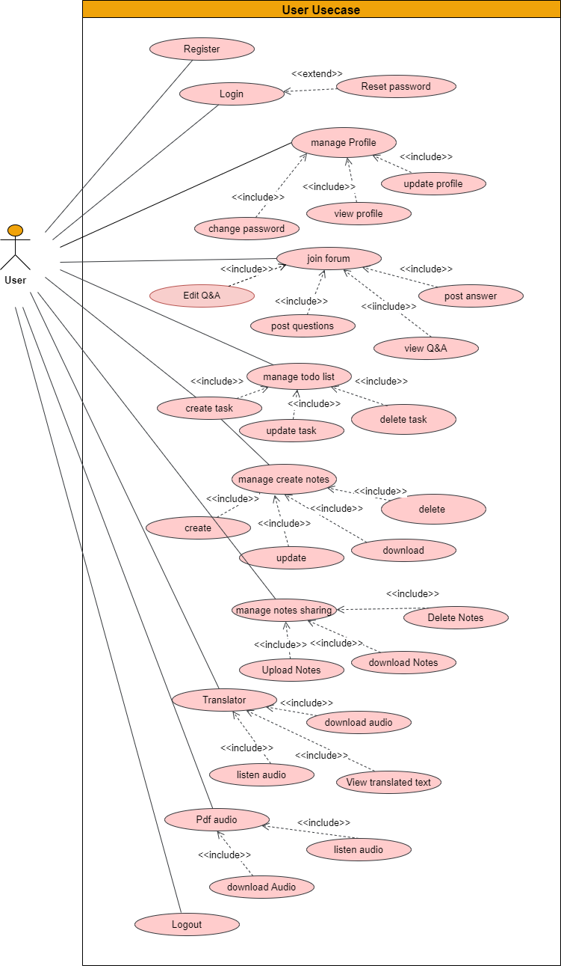
User Use case diagram

Slide 12
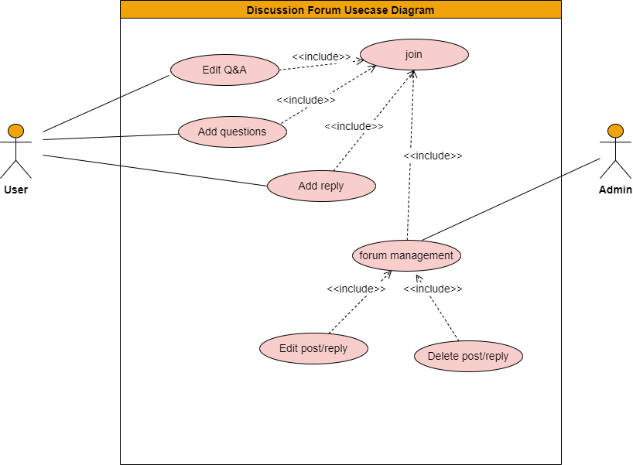

Slide 13
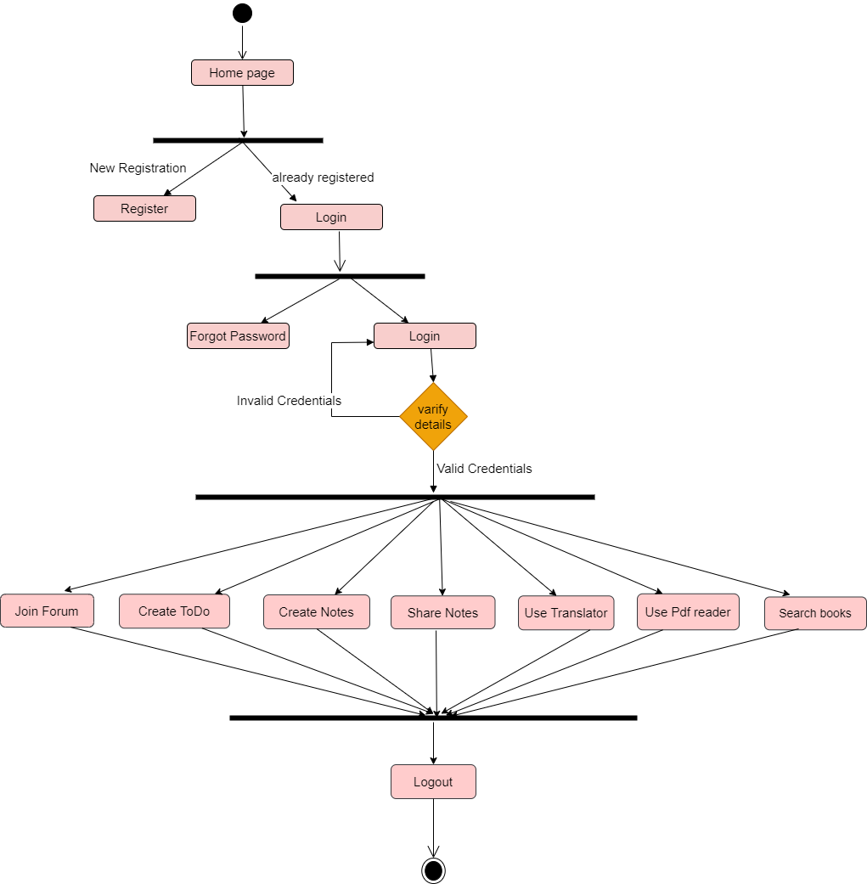
User Activity Diagram

Slide 14
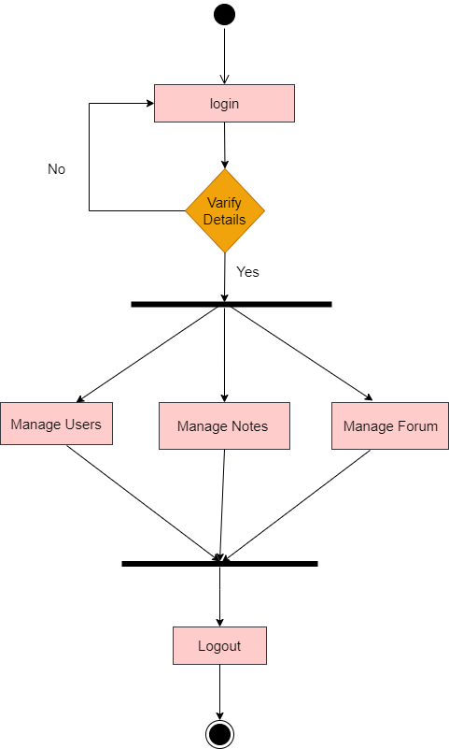
Admin Activity Diagram

Slide 15
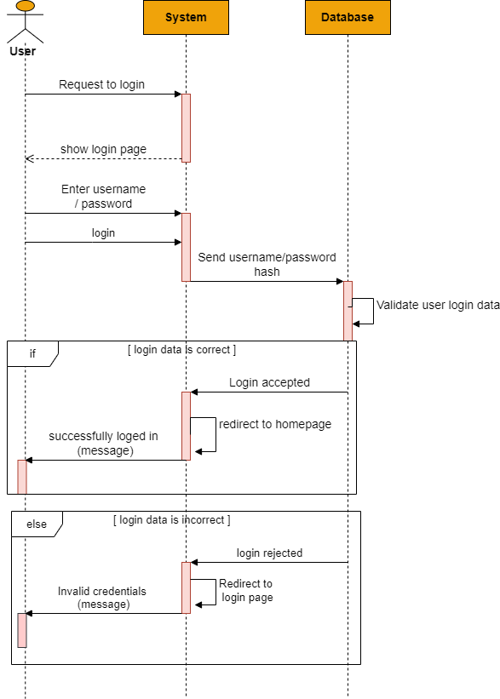
User Login Sequence

Slide 16
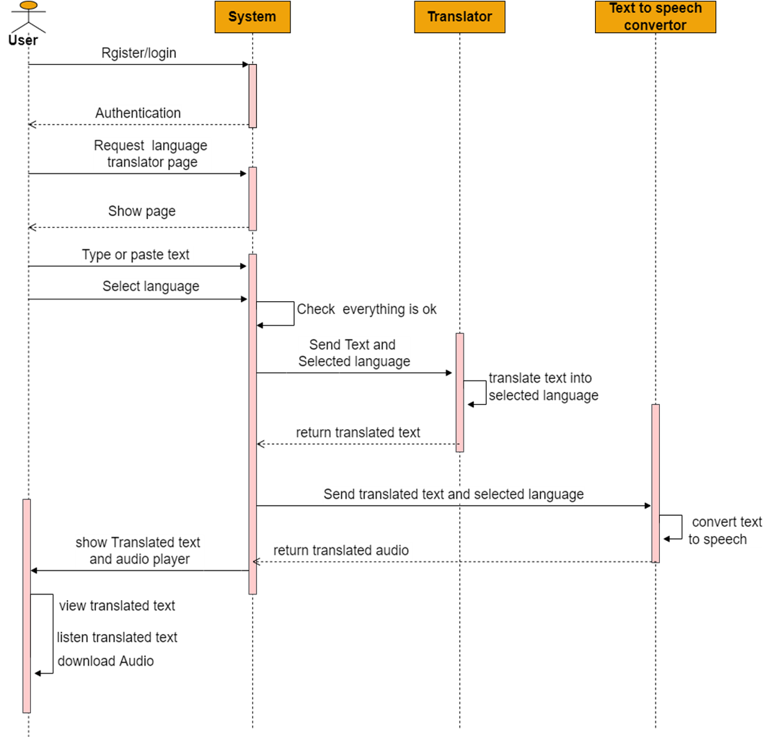
Language Translator Sequence Diagram

Slide 17
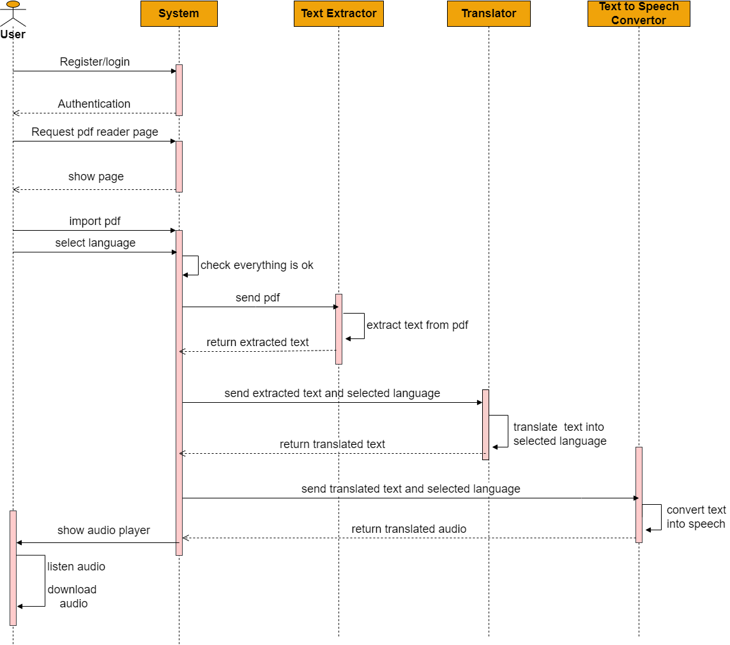
Pdf Reader Sequence Diagram

Slide 18

Study Portal home page

Slide 19


Slide 20
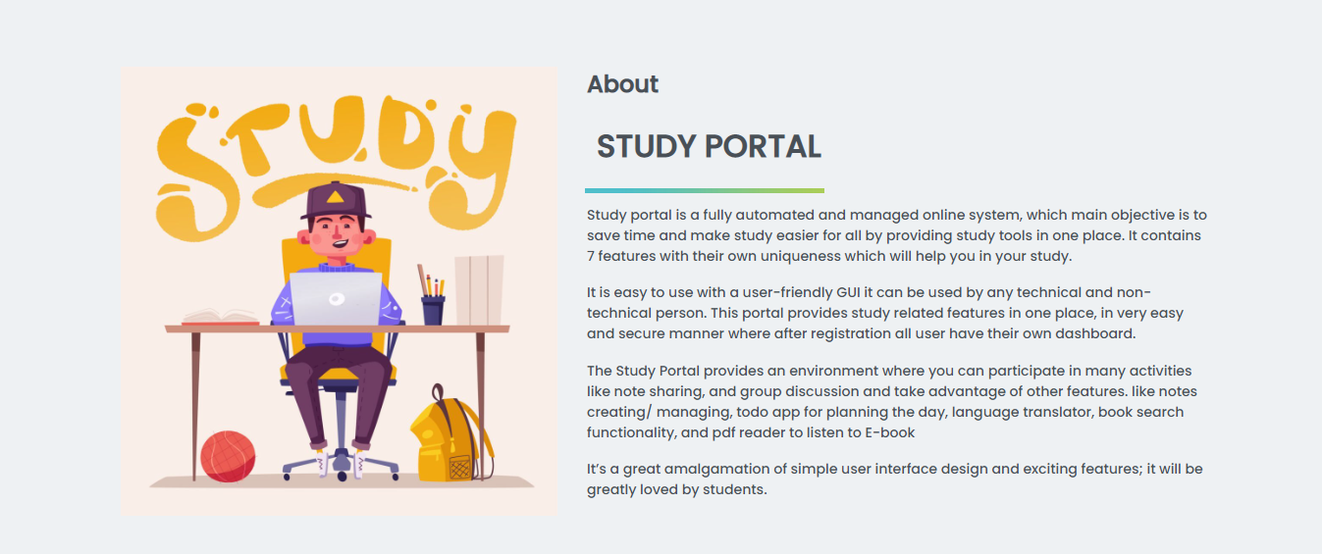
3. About

Slide 21
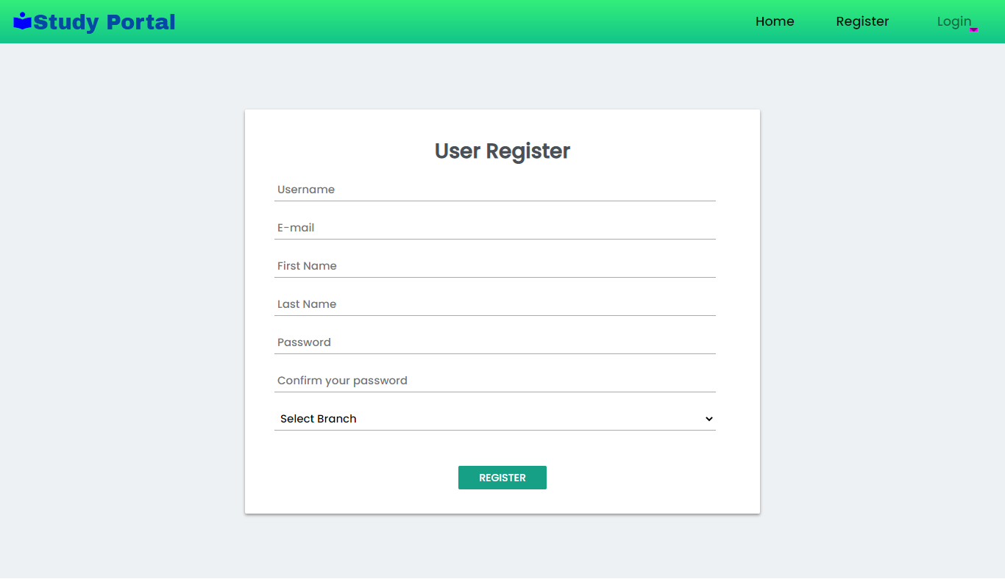
4. User Registration

Slide 22
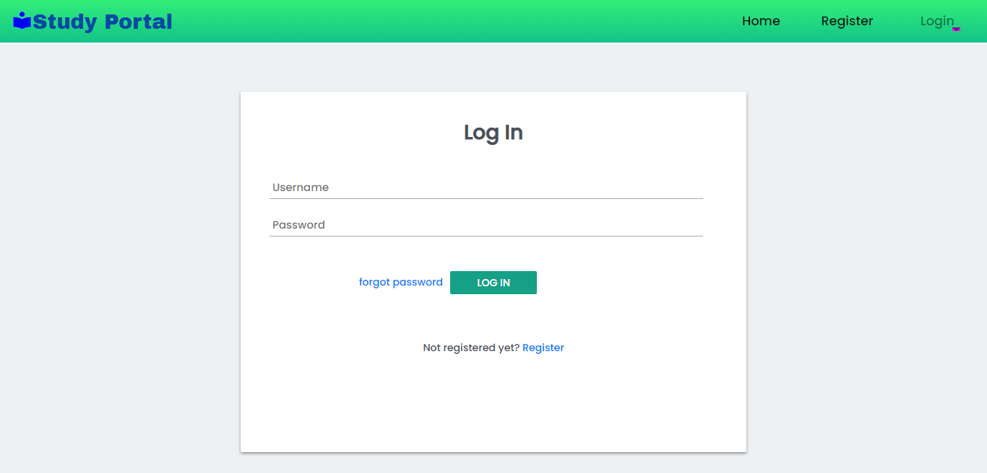
5. User Login

Slide 23
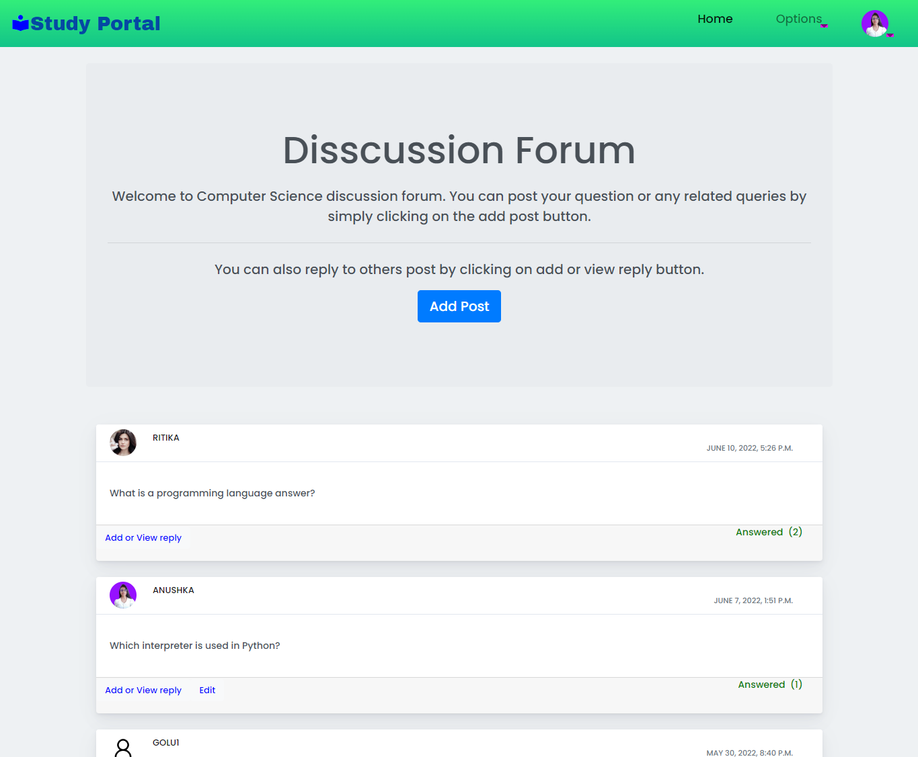
User Section screenshots
6. Forum

Slide 24
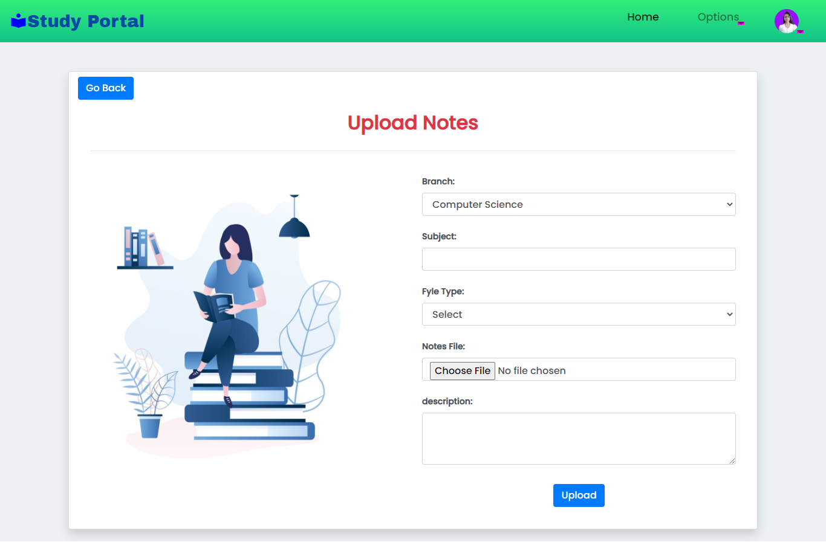
7.Upload Notes

Slide 25
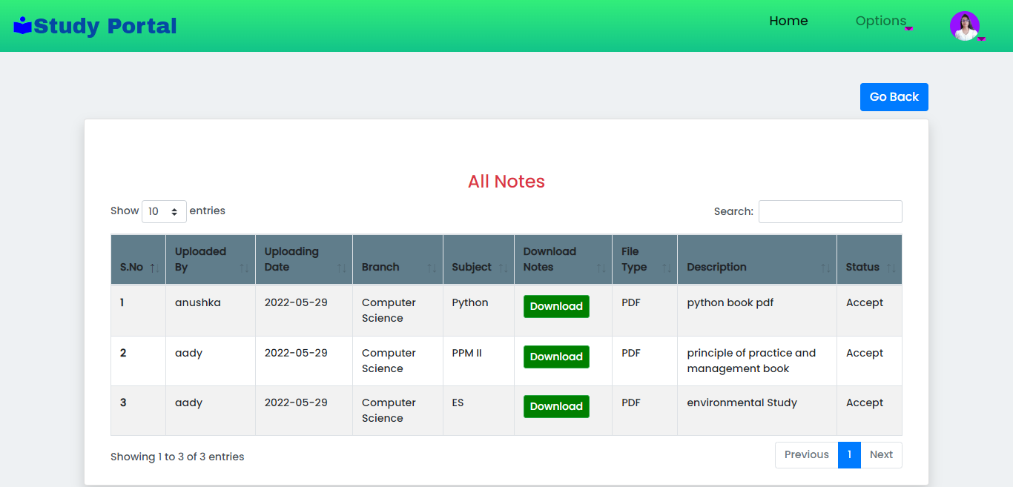
9) All Notes

Slide 26
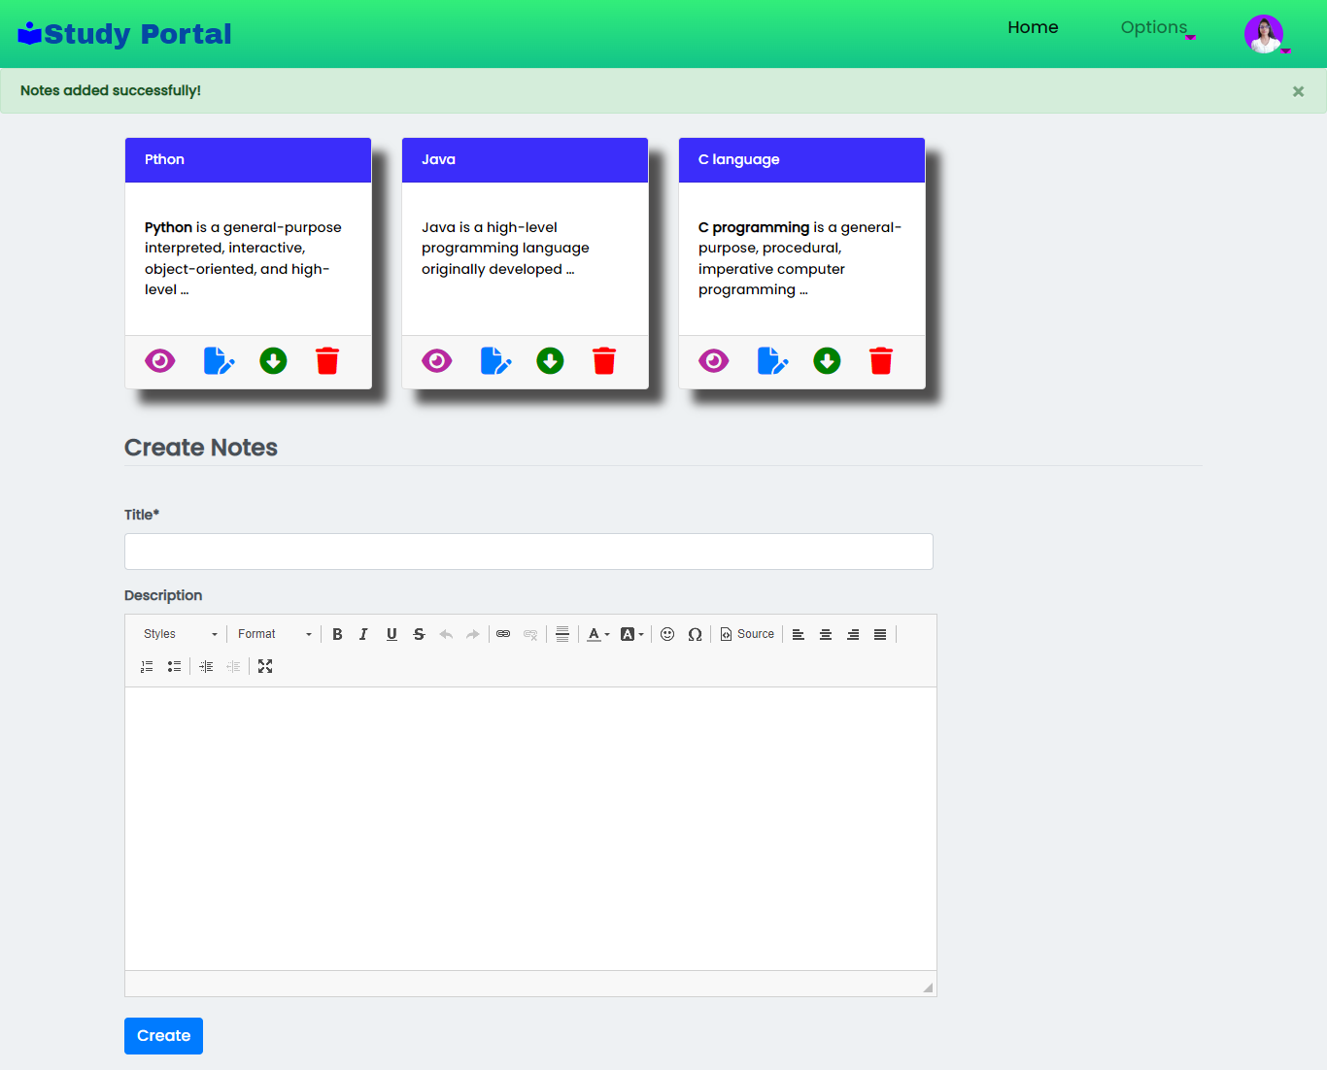
10) Create Notes

Slide 27
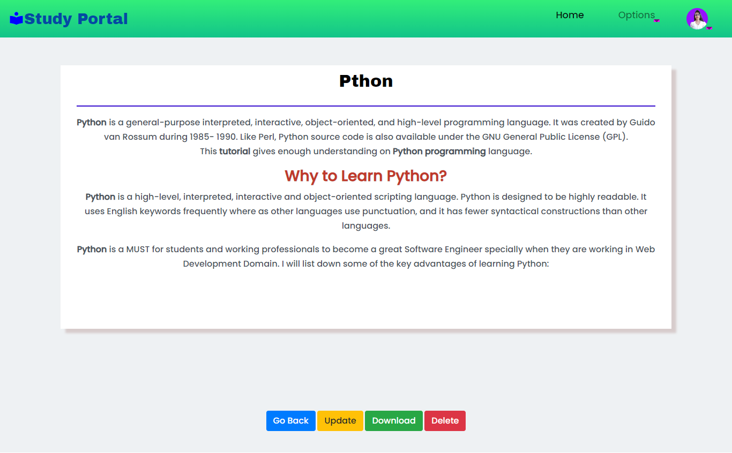
11) Create Notes Details

Slide 28
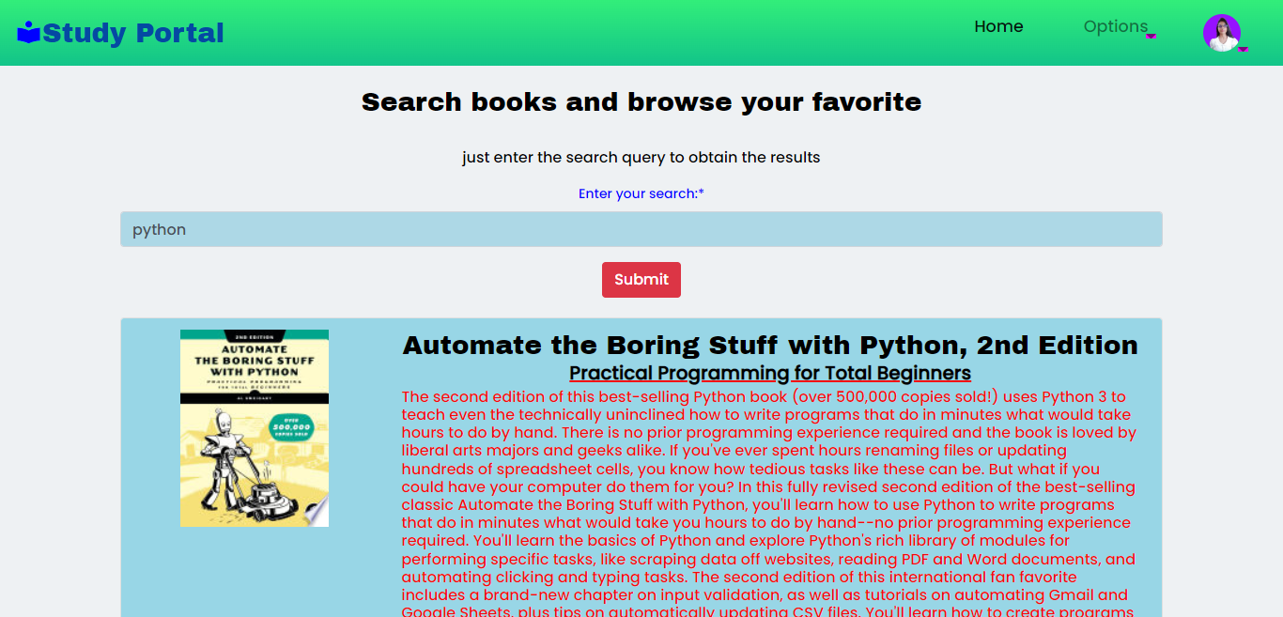
12) Book Search

Slide 29
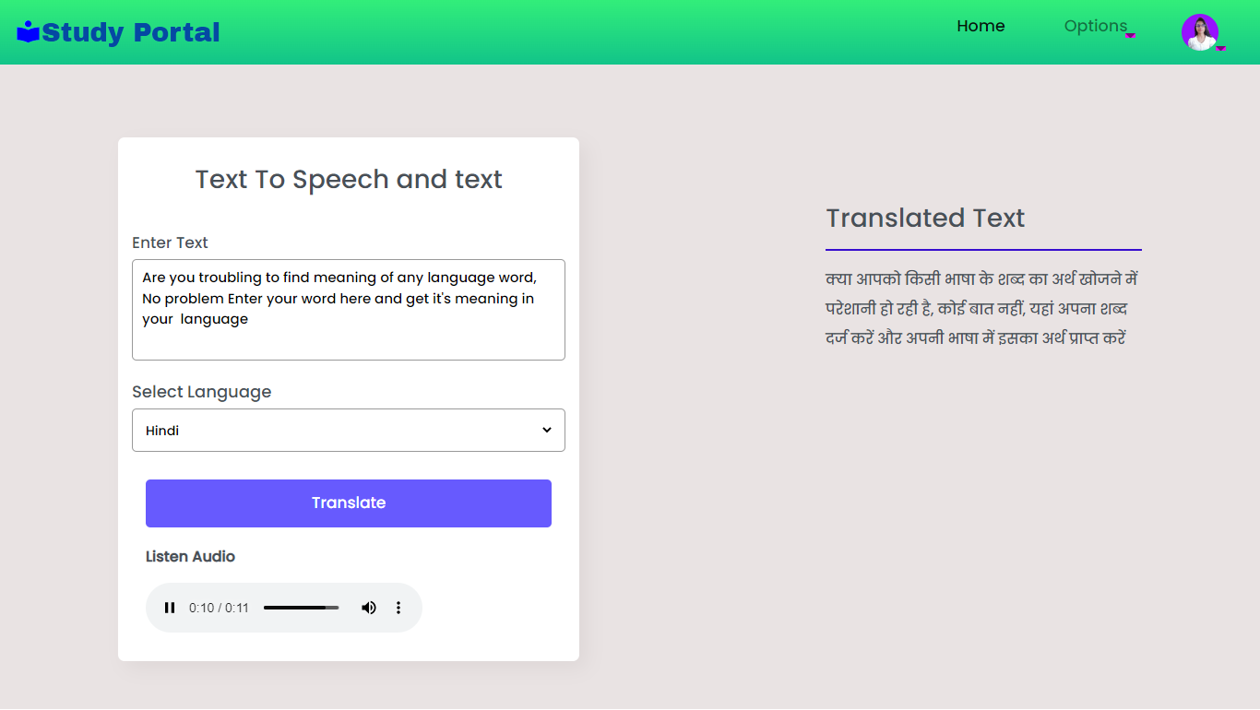
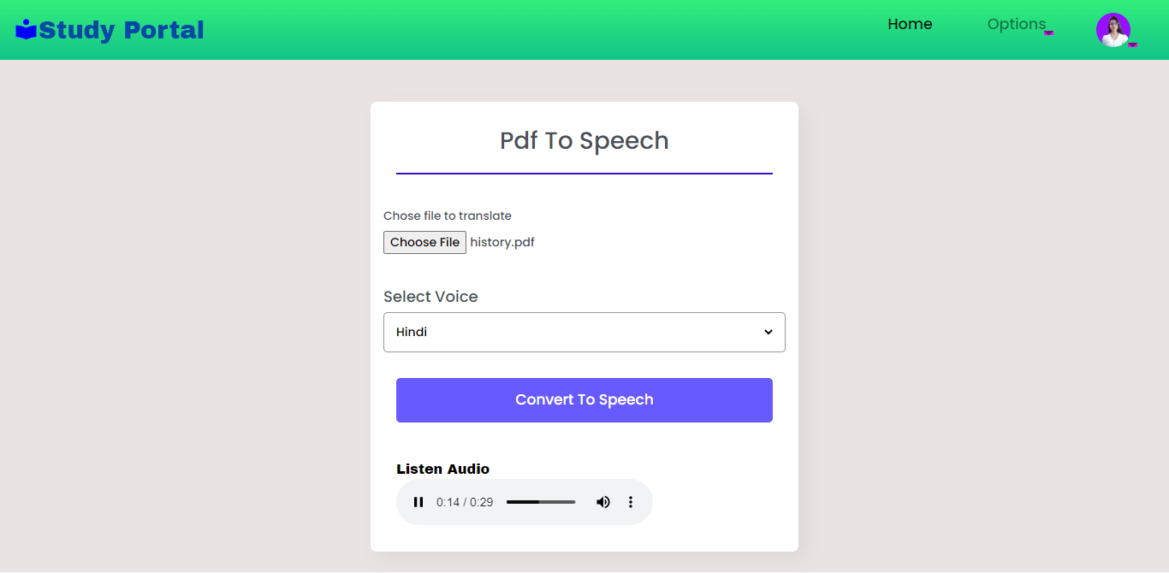
13) Language Translator & Pdf Reader
14)

Slide 30
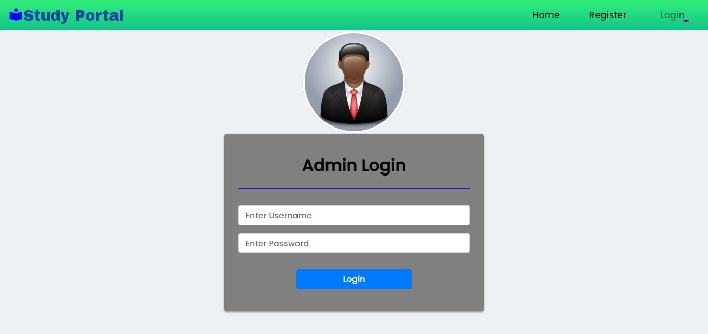
Admin Section Screenshots
15) Admin Login

Slide 31
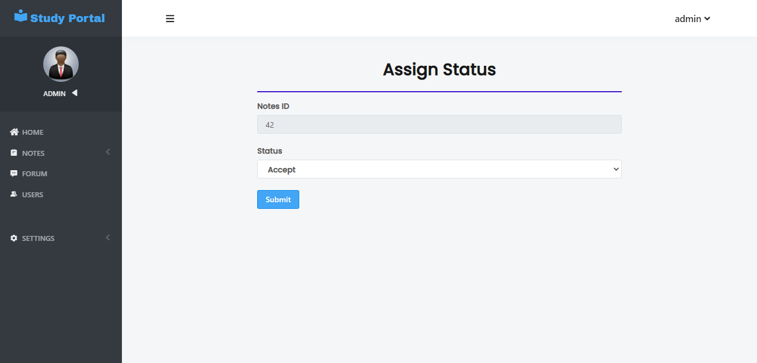
16) Assign to uploaded Notes Status

Slide 32
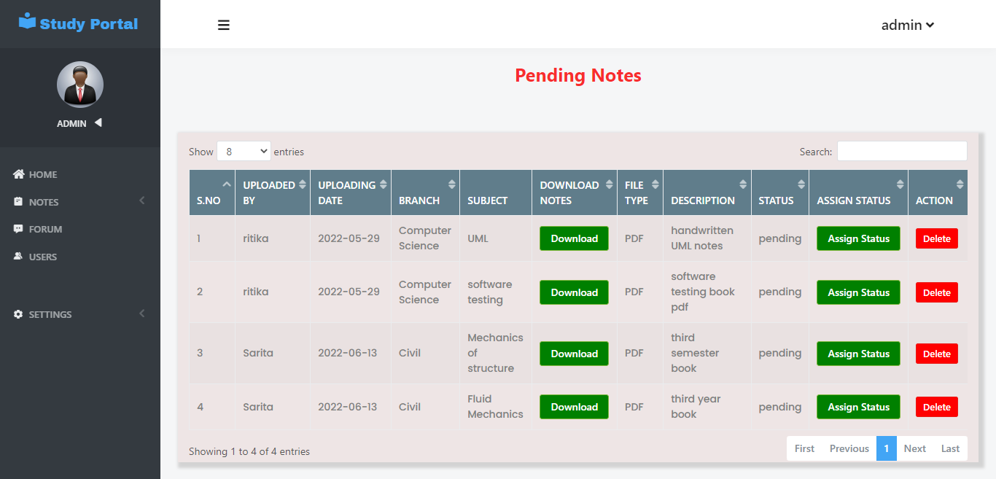
17) Notes Upload Request page:

Slide 33
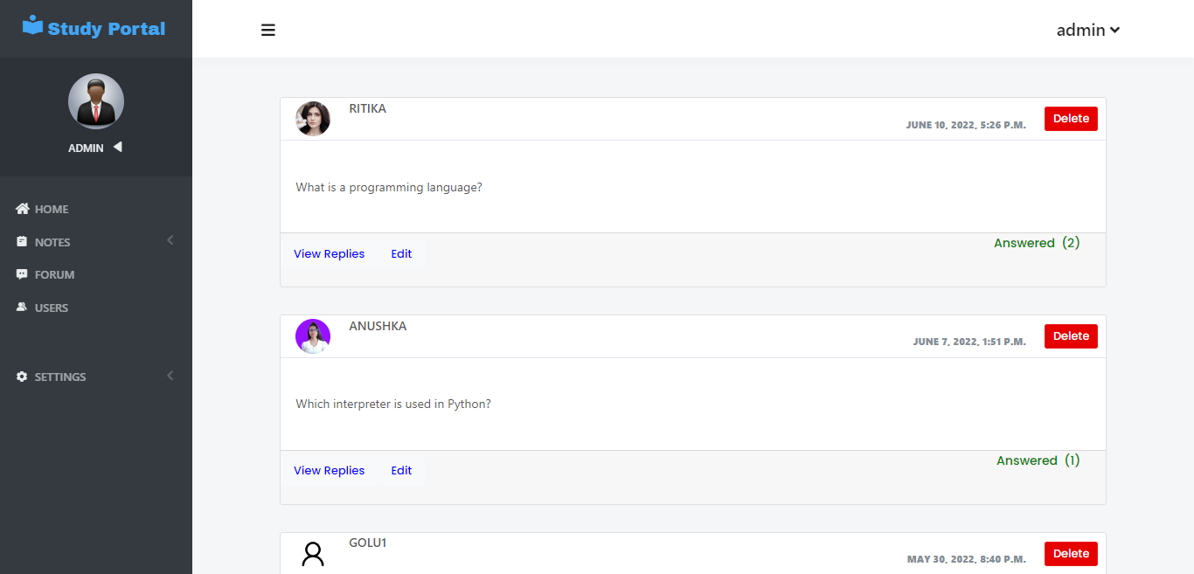
18) Manage Post

Slide 34
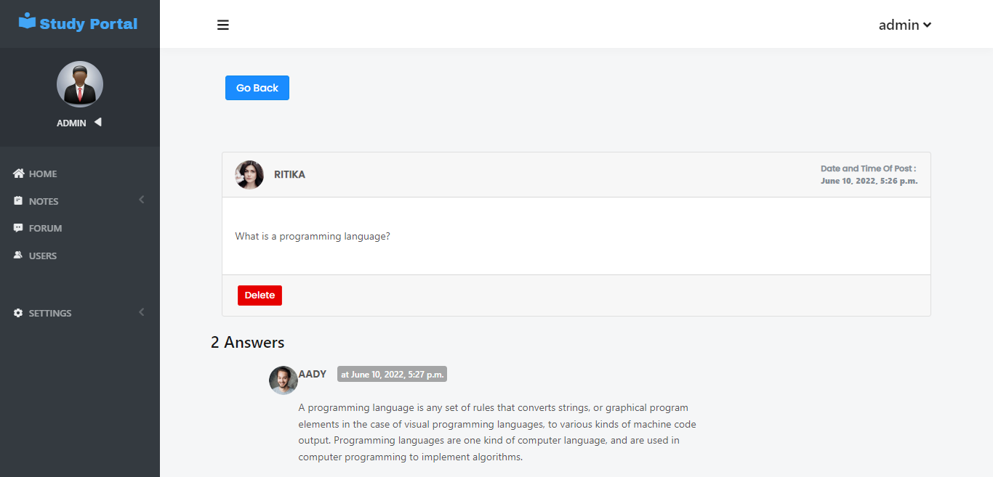
19) Manage Replies

Slide 35
Conclusion
Finally, it can be said that Study Portal is really helpful in the study as It provides managed environment containing amazing features which allow the user to access study notes uploaded by others and user also can share their own notes and discuss queries related to their stream and the user will be able to use all features like create notes, to-do, language translator, book search functionality, and pdf reader according to their need. It is not intended for a particular organization this project going to develop generic software, which can be used by any Study organization.

Slide 36
References
https://stackoverflow.com/
YouTube - http://www.youtube.com/
https://docs.djangoproject.com/en/4.0/
https://www.w3schools.com/
https://www.google.com

Slide 37
Thank You For Being Here Today I Really Appreciate That You Took The time To Be Here And Listen To My presentation

